Slide 1
Poisson Matting (ID:25)
Team: MADE ONLINE
Mentor : Prajwal Krishna Maitin
Avani Gupta (CSD) (2019121004)
Jayati Narang (CSE) (2018101066)
Kajal Sanklecha (CSE) (2019801006)
Ansh Puvvada (ECE) (2018102035)
https://github.com/Digital-Image-Processing-IIITH/project-made-online

Slide 2
CONTENTS
Global Matting
Local Matting
Boosting Brush
Clone Brush
High Pass
Diffusion Filtering
Channel Selection
Applications
Multi Background

Slide 3
GOALS
Matting for natural images in complex scenes by calculating the gradient of matte from image.
Solving Poisson equation.
Integrating user's knowledge and calculating matte in semi-supervised way(global and local matting)

Slide 4
IMAGE MATTING

Slide 5
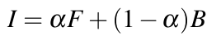
Image matting involves the following steps:
Image matting in our setting refers to foreground extraction from any given image.
A new image can be blended from a background image and foreground image with its "alpha matte".
where F is the foreground, B is the new background and alpha is the matte calculated
In natural image matting: αlpha, F and B need to be estimated.

Slide 6
GLOBAL MATTING

Slide 7
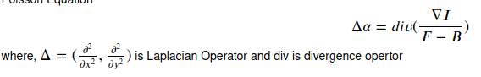
STEPS INVOLVED
Global matting involves the following steps:
Find approximate foreground and background using an alpha.
Find the Poisson Equation for this image.

Slide 8
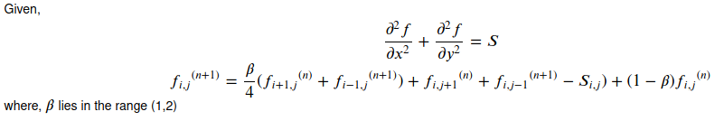
STEPS INVOLVED
3. Apply the following Gauss Seidel Iteration to find a good approximate for alpha.
4. Use this alpha to get the final new image.

Slide 9
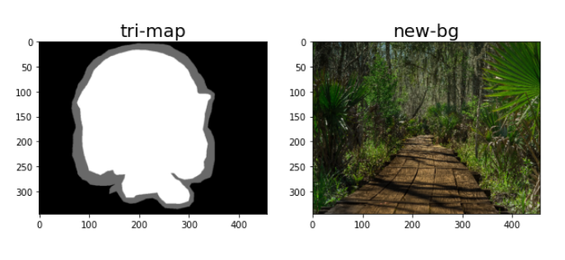
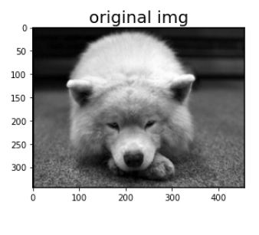
Working of global matting (inputs)
Definite foreground
Definite background
unknown region

Slide 10
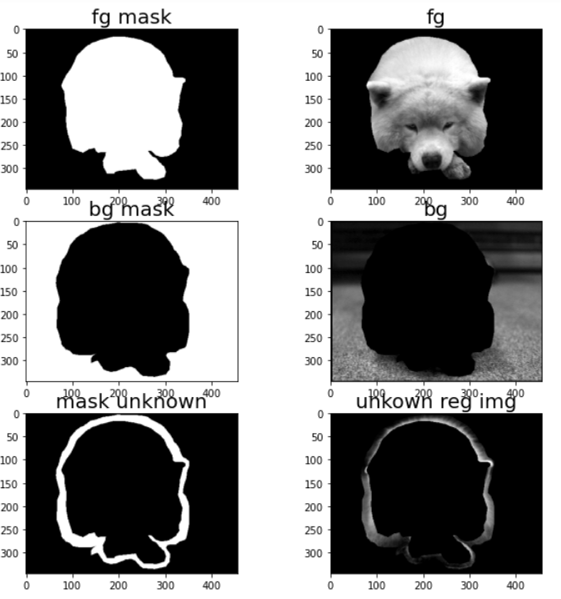
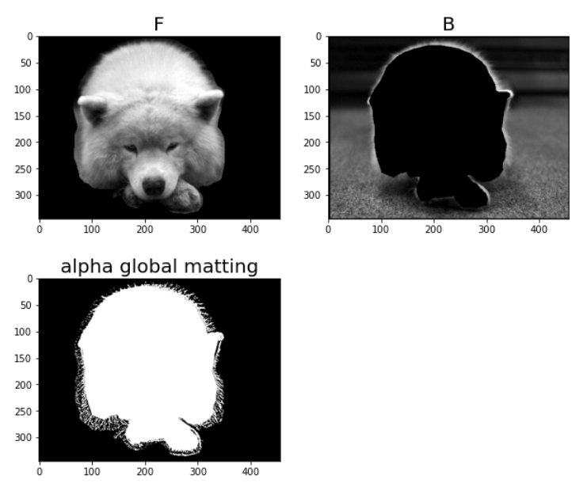
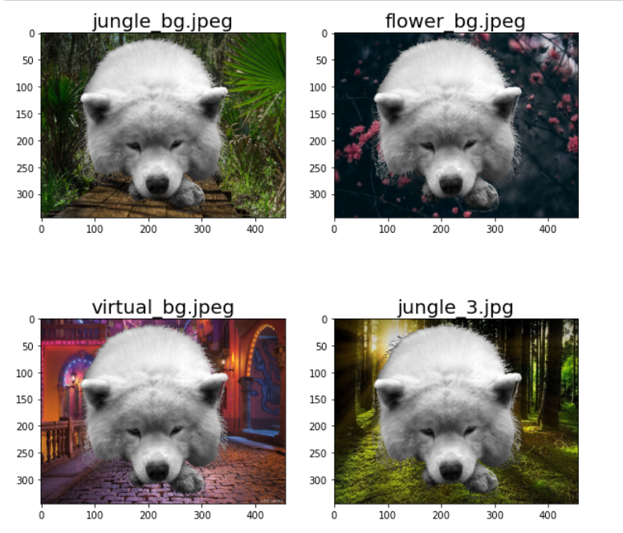
working of Global matting
(Outputs)

Slide 11
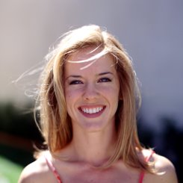
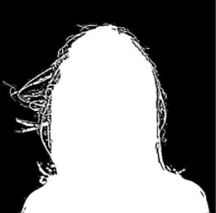
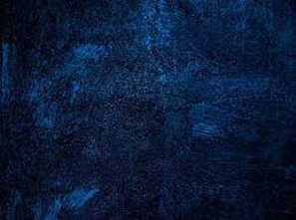
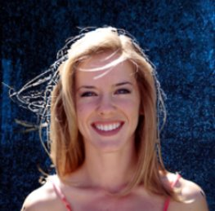
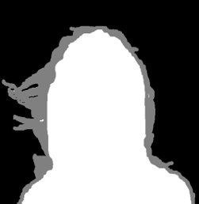
Image
Estimate Matte
New Background
Image with new bg​
Trimap

Slide 12
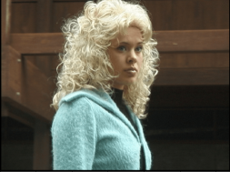
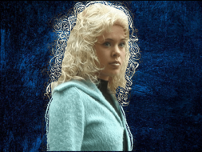
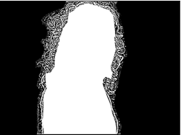

Image
Estimate Matte
New Background
Image with new bg​
Trimap

Slide 13
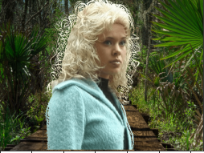
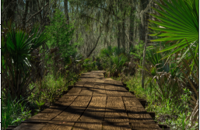
Image
Estimate Matte
New Background
Image with new bg​
Trimap

Slide 14
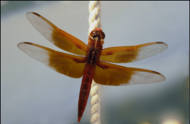

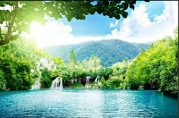
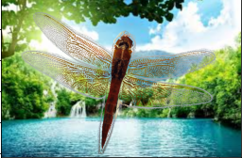

Image
Estimate Matte
New Background
Image with new bg​
Trimap

Slide 15
LOCAL MATTING

Slide 16
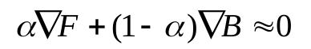
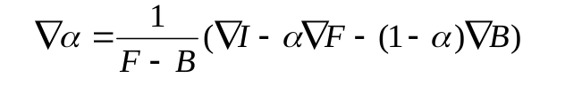
Poisson Matting in Local Region
To refine the result of poisson matting, the user can select regions to improve the matte.
This is needed when the background/foreground is complex and the assumption fails.
Hence now we have to solve this new poisson equation
Where F and B are initial foreground and background image and ɑ is alpha estimated from global matting.

Slide 17

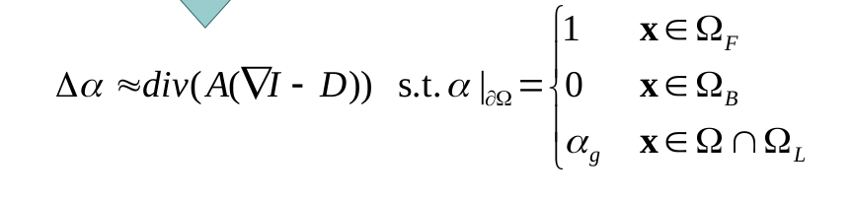
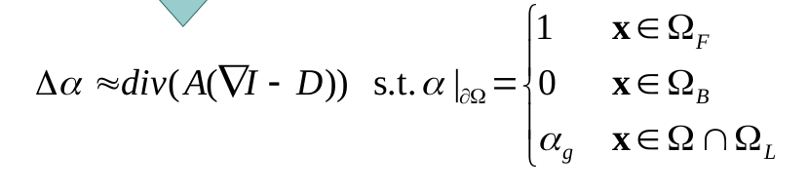
Local Matting by solving Poisson equation
Above equation can be written as
This solves to the following.
This can be solved using similar to that of global matting.

Slide 18

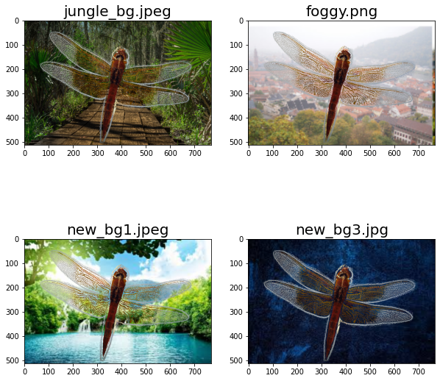

Global Matting
Local Matting

Slide 19
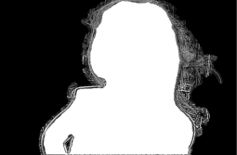

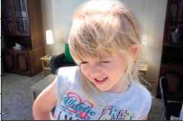
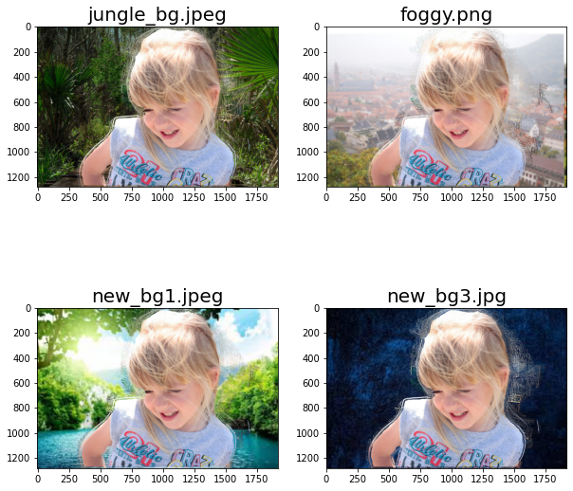
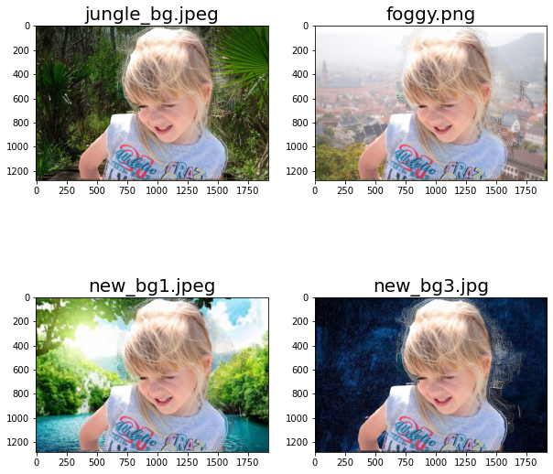
Global Matting
Local Matting

Slide 20
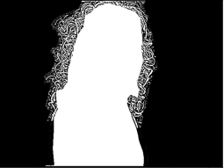
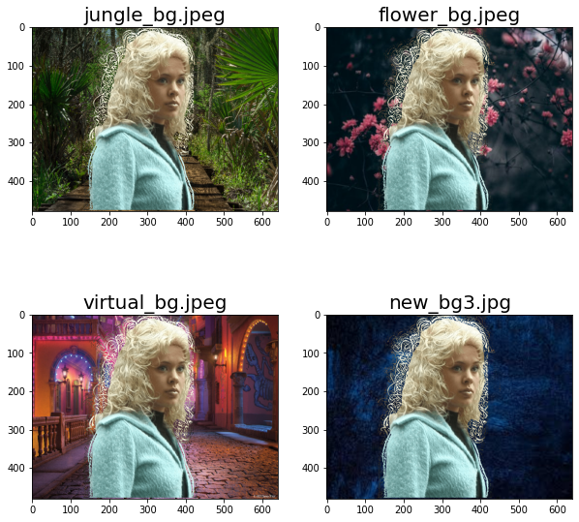
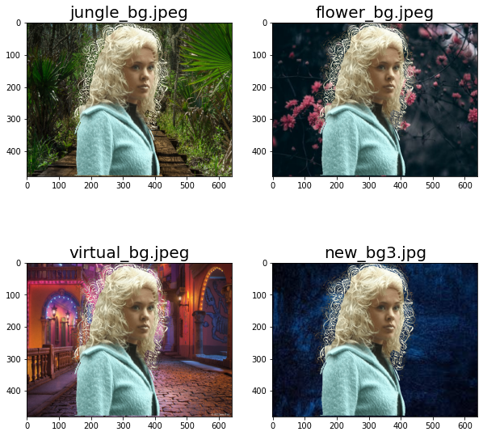
Global Matting
Local Matting

Slide 21
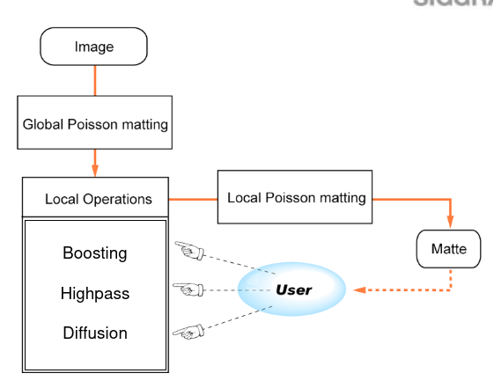
Local Operations: Refinement
We have implemented the Local Filtering Operations to improve the matte:
Diffusion (remove noise)
Highpass (get ~D)
Boosting (manipulate A)

Slide 22
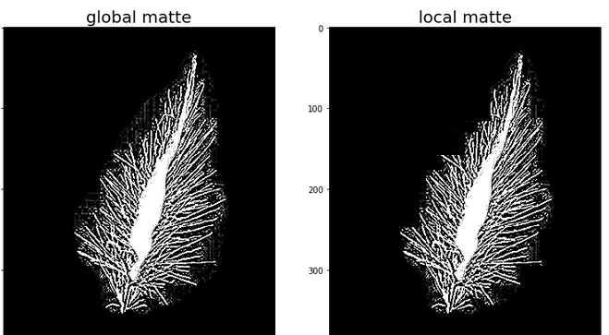
Diffusion filtering
Since the image gradient is sensitive to noise, hence anisotropic diffusion is applied on images whenever required[Perona and Malik. 1990] to diffuse image. Then this diffuse image is used for any further local matting.

Slide 23
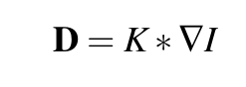
High-pass filtering
The channel selection operation generates a smooth background or foreground, leading to low frequency gradients. Therefore, D is be estimated using the low-frequency parts of the image gradient:
where K = N(p; p₀ , σ² ) is a Gaussian filter centered at pixel p₀ and ∗ is the convolution operator.
The matte is estimates as: ∇α =A(∇I − K ∗ ∇I),
where (∇I − K ∗ ∇I) corresponds to a high-pass filter.

Slide 24
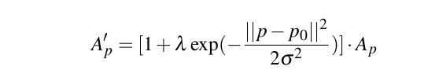
Boosting brush
It smoothes or sharpens the matte by increasing/decreasing A.
It is modifies the Area A_{p} to A_{p}' as:
where p0 is the coordinate of the brush center,
σ and λ are user defined parameters which control the size and strength of the boosting.

Slide 25
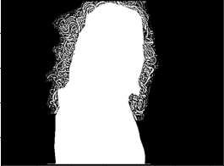

Global Matting
Refinement

Slide 26
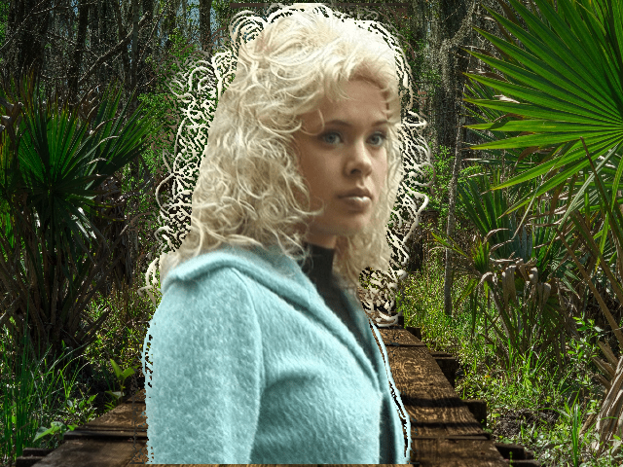
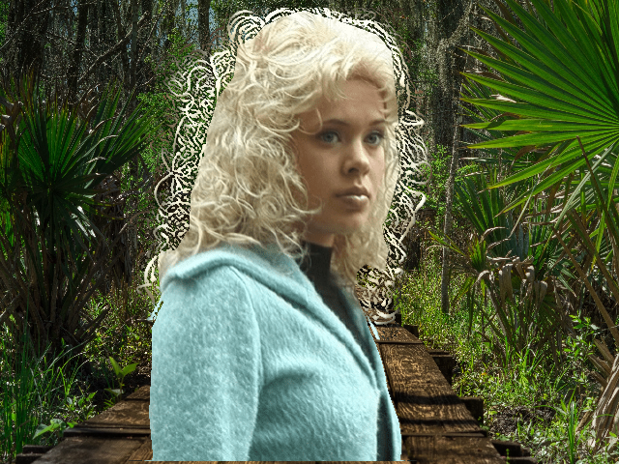
Global matting vs Refinement

Slide 27
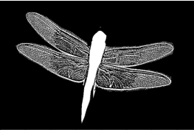

Global Matting
Refinement

Slide 28
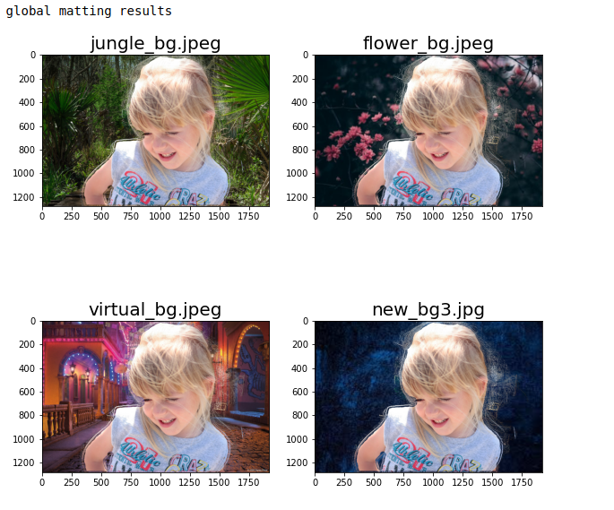
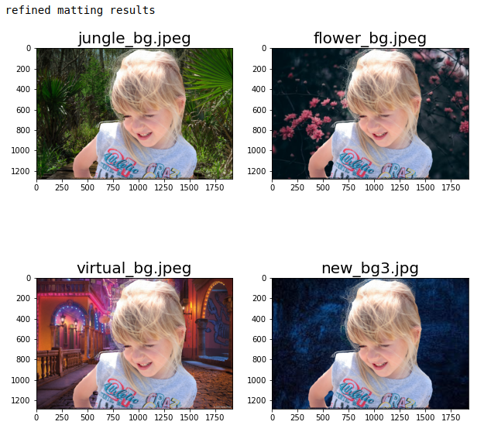

Slide 29
Channel Selection

Slide 30
Channel Selection
For colour images, the poisson equation can differ for each channel. (R/G/B channel)
We try to construct a new channel γ = aR + bG + cB with a smooth Background or Foreground.
This way we minimize the variance of the Foreground or Background colors.

Slide 31
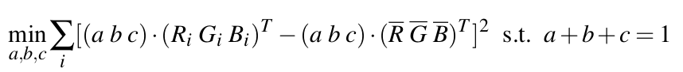
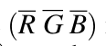
Steps
Select the Region of Interest where we wish to apply Channel Selection
Compute the weights (a b c) to minimize the sample variances in the new channel. This is solved using the following minimization:
where are the Mean Intensity in each channel
Note: This implementation was carried out but we were unable to find an appropriate image for the same

Slide 32
APPLICATIONS

Slide 33
Multi-Background
When a user has multiple images with same foreground but different background multi-background method can be used to obtain matte.
Involves finding:
mean image
Matte of mean image
Core idea: foreground is same in all images, mean of extracted backgrounds is calculated, Foreground and background are merged to produce mean-image which is used to calculate matte.

Slide 34
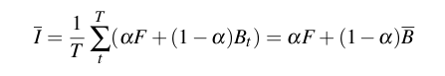
Multi-Background
Poisson matting when multiple images with same foreground but different background gives better result on mean image which is given as:
where, T is number of images, alpha is estimated matte of one image, F is estimated foreground, B_{t}: estimated background, is mean bg.

Slide 35
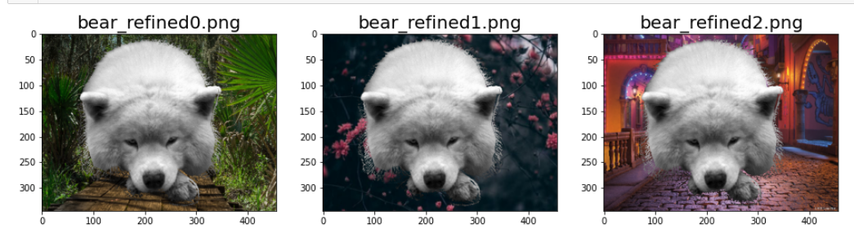
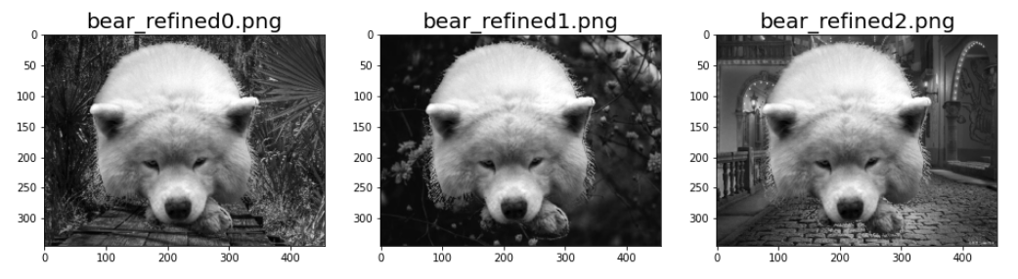
Mean-bg (input images)
RGB Images
Corresponding Gray-Scale Images

Slide 36
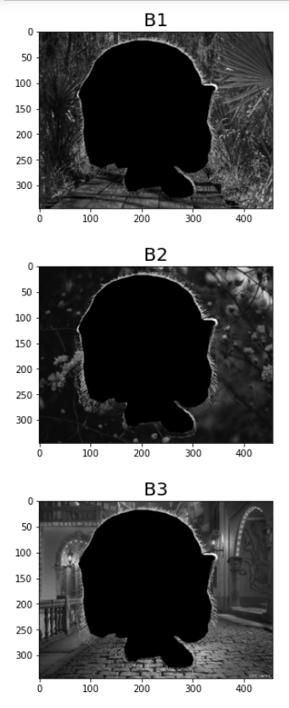
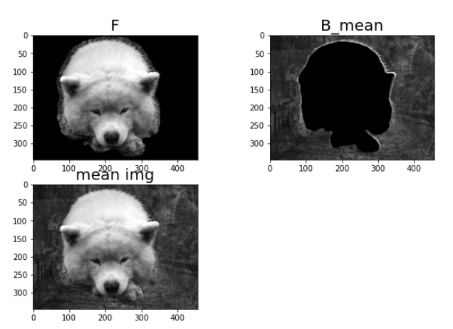
Notice: the mean image, is combination of gray-scale input images
Extracted backgrounds

Slide 37




<- Input images
Output images on new bg
Mean gray image
Matte
Notice: the density and volume of hair reduces

Slide 38
Work Division
NAME | PARTS ASSIGNED
Ansh Puvvada | Global Matting, Fine Tuning of Mattes, Channel Selection
Jayati Narang | Local Matting, Diffusion filtering, Fine Tuning of Mattes
Avani Gupta | Boosting brush, Refinement of mattes, Multi-Bg, Fine Tuning of Mattes
Kajal Sanklecha | Clone brush, Documentation

Slide 39
Demo Time!

Slide 40
THANK YOU

